Slide 1


Embedded Systems Workshop
Session
1

Slide 2



Hello!
Instructor: Mariam Ahmed.
Cairo University, EECE Department.

Slide 3

Embedded Systems Workshop

Slide 4
Content
• What is Embedded Systems?
• Microcontroller vs Microprocessor
• AVR family overview
• Memory map (Flash / SRAM / EEPROM)
• Registers
• Datasheet reading
• Clock system
• Polling vs Interrupt

Slide 5

What is Embedded Systems?

Slide 6






Slide 7



Embedded Systems
An embedded system is a specialized system that is designed to perform dedicated functions.
Embedded systems are real-time systems.
Embedded systems are part of a bigger product
Notes:
Tie each point with the previous examples,
For example: dedicated functions -> washing machine
real-time -> traffic light system
part of a product -> smart watch

Slide 8
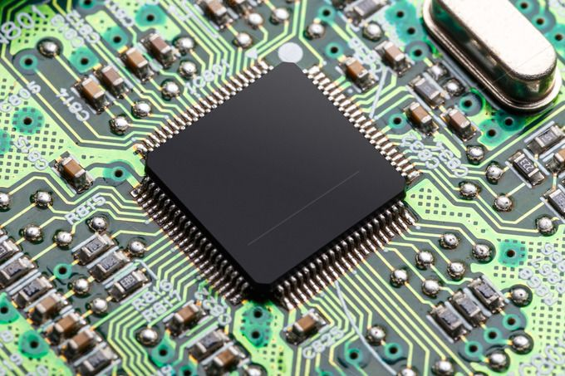
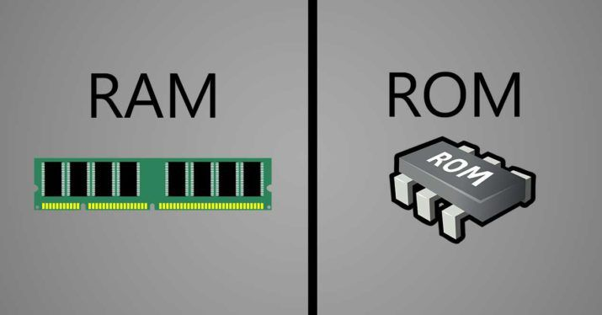
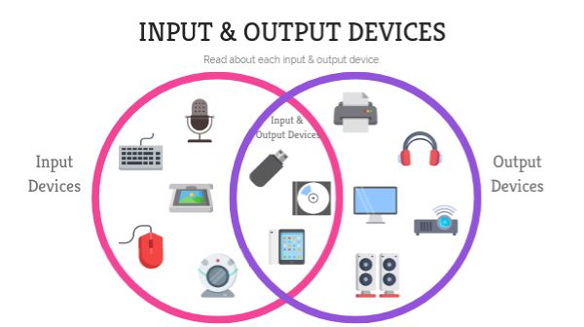
Computing systems
CPU
Memory
I/O Peripherals
Notes:
Know why the difference in shape between the ram and the rom (just in case someone asked)
Know how to zoom in so that ur able to show the I/O peripherals clearly

Slide 9
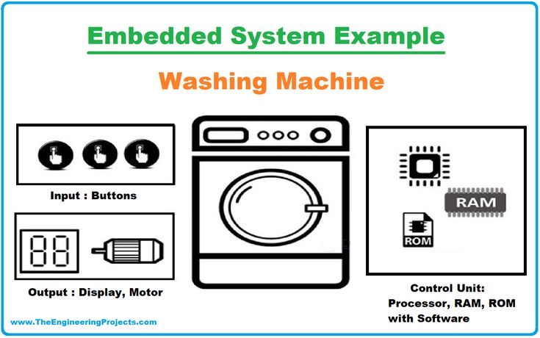
Embedded systems
An embedded system is a computing system that:
Uses a processor to execute a dedicated control program.
Uses memory to store program code and system data.
Uses input/output Peripherals to interact with sensors and actuators.

Slide 10


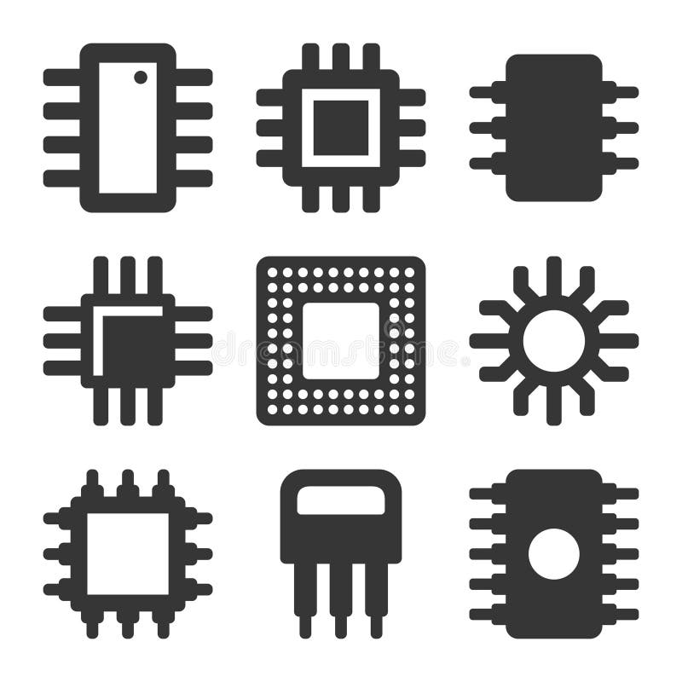

Embedded system challenges
High Performance
Low Cost
Low Power Consumption
Small Size

Slide 11
Microcontroller vs Microprocessor

Slide 12
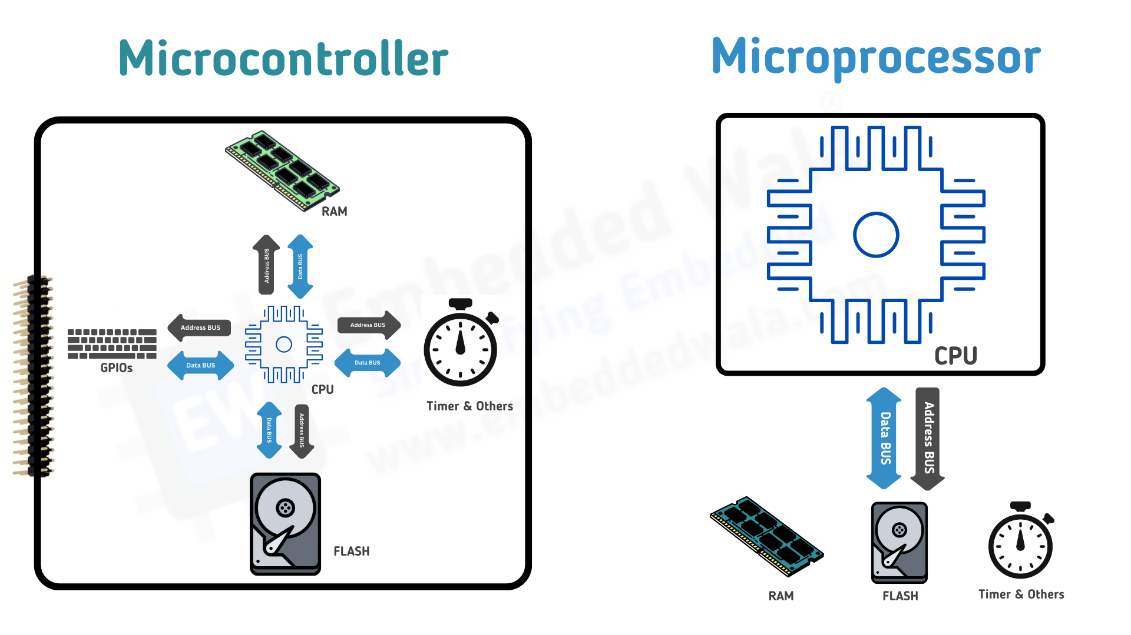
Microcontroller vs Microprocessor
Microcontroller
Microprocessor

Slide 13
Microcontroller vs Microprocessor
Microcontroller | Microprocessor
A computing system on a chip (CPU, Memory, I/O Peripherals) | CPU only (needs external memory and I/O peripherals)
Designed for dedicated functions | Designed for general-purpose computing
Has relatively lower processing speeds and less power consumption | Has high processing speeds and power consumption

Slide 14
AVR Family Overview

Slide 15
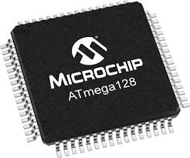
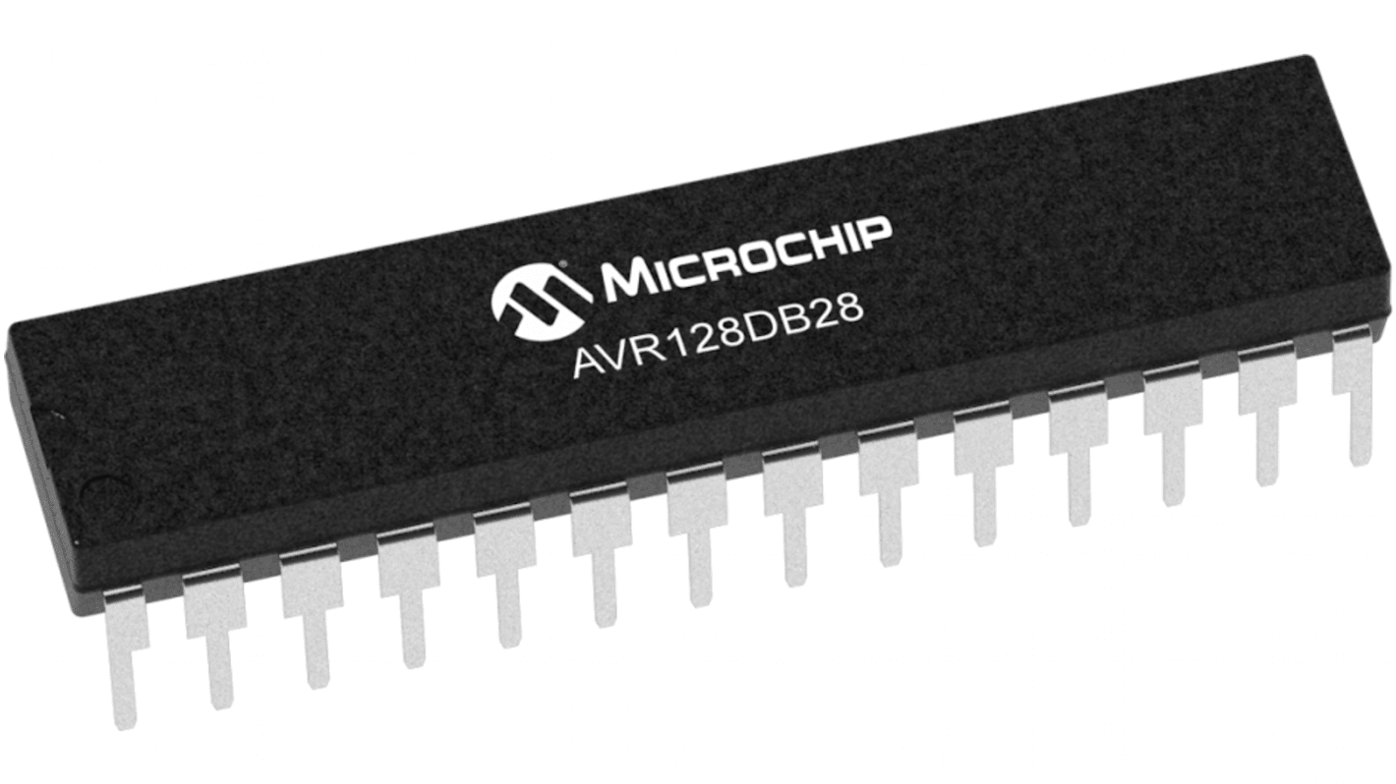
AVR Microcontroller Family
Developed by Atmel (1996) → acquired by Microchip (2016).
8-bit RISC architecture.
Harvard memory structure.
Supports serial communication protocols (ex. UART, I2C SPI).
Has integrated memory: SRAM, Flash, EEPROM.

Slide 16
AVR Microcontroller Family
Family | Characteristics | Examples
Classic | Early AVR Devices | AT90S series
Tiny | Small size, limited memory, low power consumption | ATtiny13, ATtiny85
Mega | Larger memory and peripherals | ATmega32, ATmega328P
Special Purpose | Application specific MCUs | USB AVR Devices

Slide 17
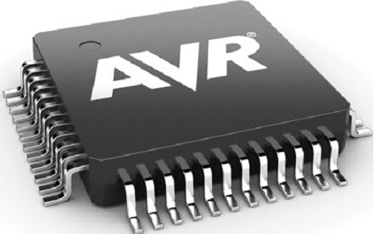
AVR Microcontroller Family
Why AVR?
Simple architecture
Teaches low-level embedded programming
Clear example of memory-mapped I/O
Strong foundation in register-level control
Helps understand bit manipulation and digital logic
No heavy abstraction and direct hardware interaction
Builds fundamentals needed for ARM and modern MCUs
Ideal for learning timers, interrupts, GPIO, and peripherals

Slide 18
Memory Map

Slide 19
Memory Classification
Memory
RAM (Volatile)
ROM (Non-Volatile)
SRAM
DRAM
Masked ROM
EPROM
Flash
PROM
EEPROM

Slide 20
Memory in Embedded Systems
SRAM
CPU
Flash
EEPROM

Slide 21
SRAM
Static Random Access Memory
Volatile memory.
Used during program execution.
Stores variables, temporary data, Stack, and function parameters .
Based on transistor-based memory cells
Provides fast read and write access
Used as runtime memory for program execution

Slide 22
Flash
Non-volatile memory.
Stores program code, constants, and lookup tables.
Endurance: up to 10,000 write/erase cycles.
CPU fetches instructions directly from Flash

Slide 23
EEPROM
Non-volatile memory.
Stores data only when program intentionally reads/writes it.
Endurance: 100,000 – 1,000,000 write/erase cycles.
Optional in microcontrollers.
Can be added externally if more storage is needed

Slide 24
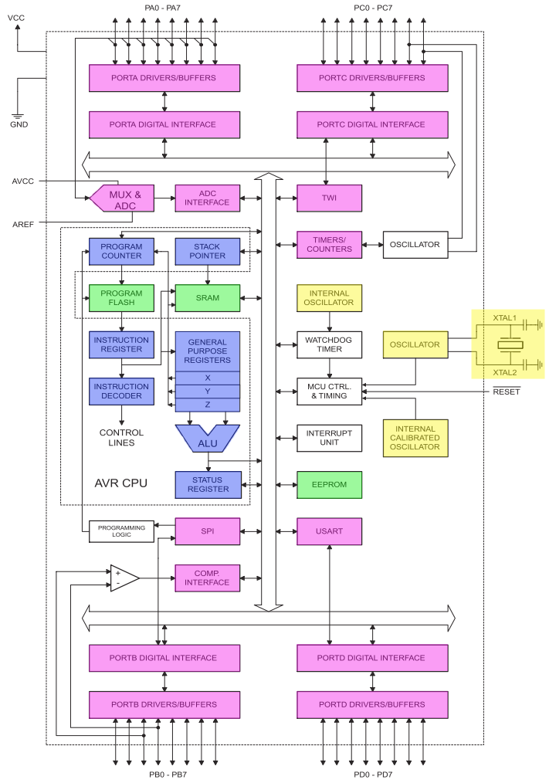
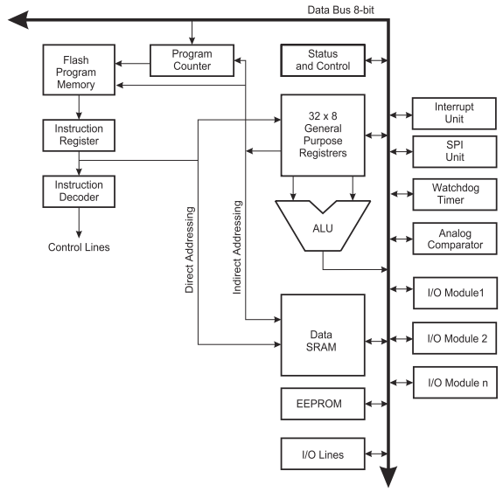
Notes:
Flash Program Memory
Connection: Directly feeds the Instruction Register and indirectly connects to the Program Counter.
Why:
Flash memory stores the program instructions (code).
The Program Counter (PC) keeps track of which instruction to execute next.
Instructions are fetched from Flash into the Instruction Register for decoding.
EEPROM
Connection: Connected to the data bus for CPU access.
Why:
Non-volatile storage for variables that must persist across power cycles.
Slower than SRAM; often accessed less frequently.
SRAM
Connection: Connected to the ALU and general-purpose registers (via memory bus).
Why:
SRAM is used for temporary data storage during execution.
CPU can read/write data here while the program runs.
Acts as slower memory than registers but faster than EEPROM.

Slide 25
Hello!
Instructor: Fatma Foley.
Cairo University, EECE Department.

Slide 26

Embedded Systems Workshop
1
My LinkedIn Profile

Slide 27
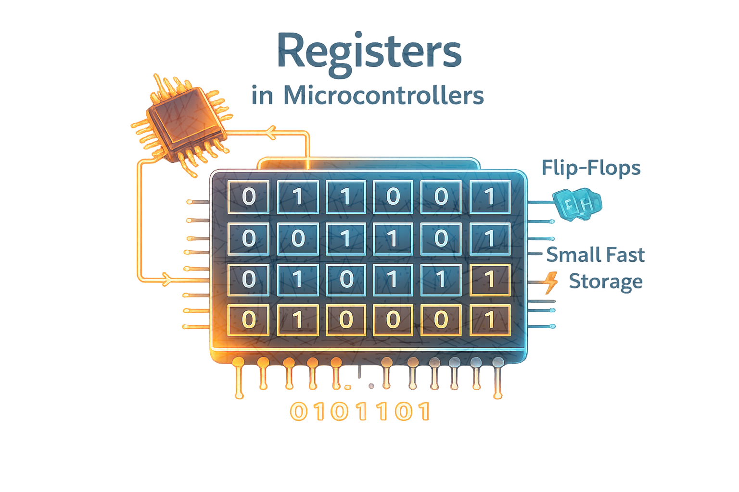
Registers

Slide 28
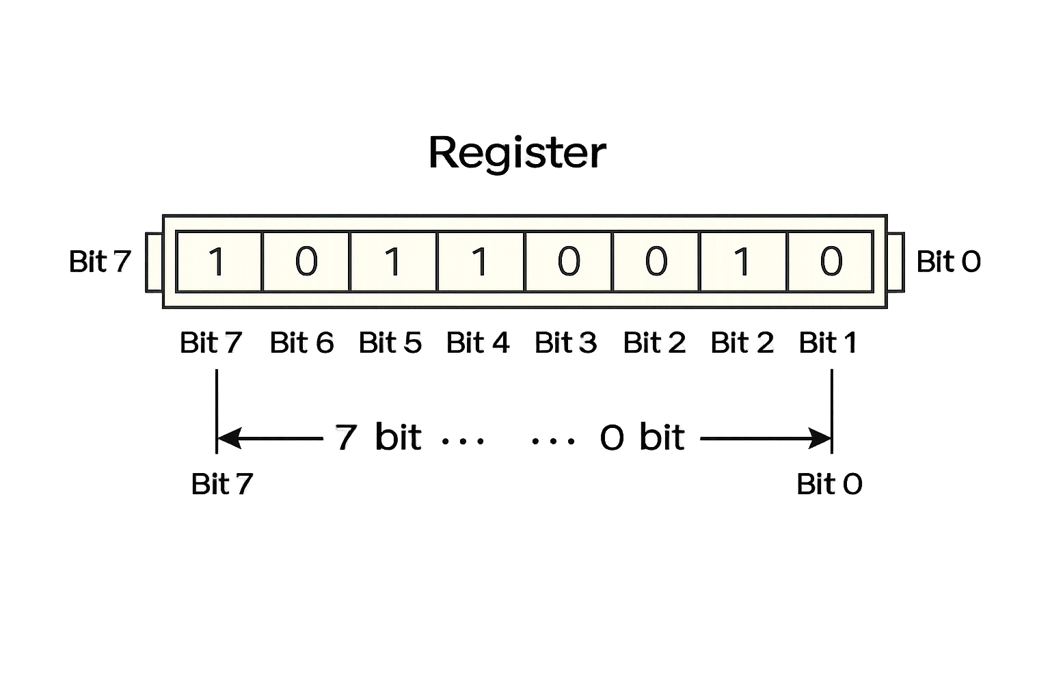
Registers
Definition: Registers are small,
fast storage locations inside the CPU
.
Usage: Used to store
(Temporary data, Control information,
Results of operations).

Slide 29
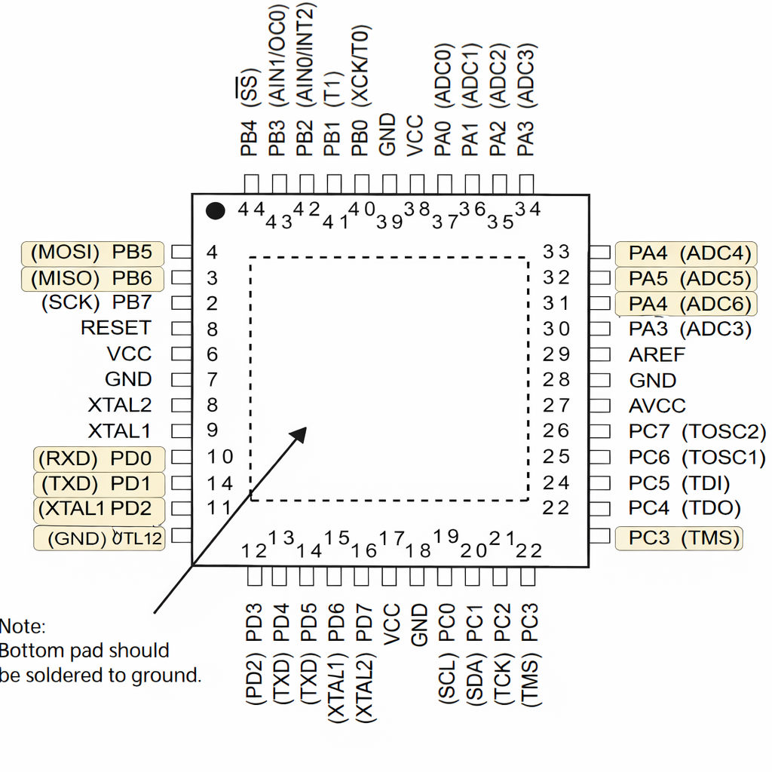
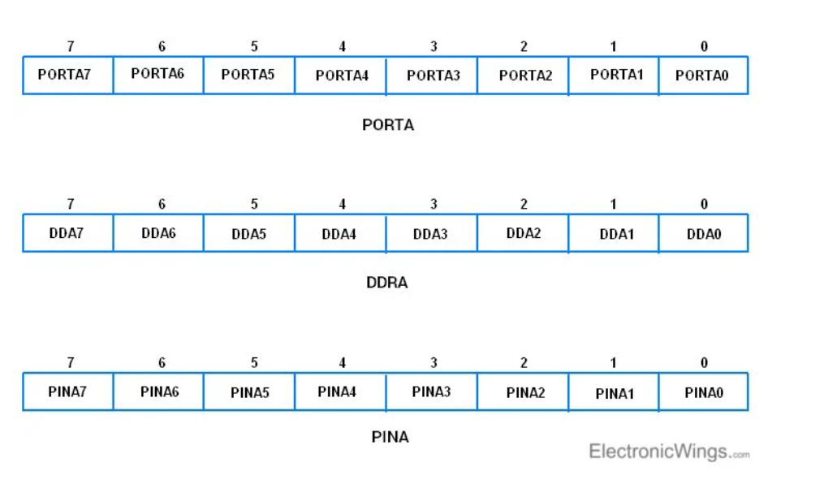
Types of registers
1- General Purpose Registers: Used for
arithmetic and logic operations.
Example: R0 – R31 in AVR.
2- Special Function Registers (SFRs):
Used to control hardware peripherals.
Example: DDRx, PORTx, PINx.

Slide 30
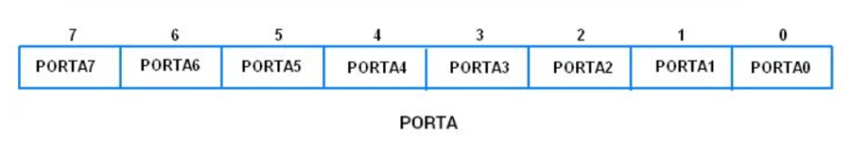
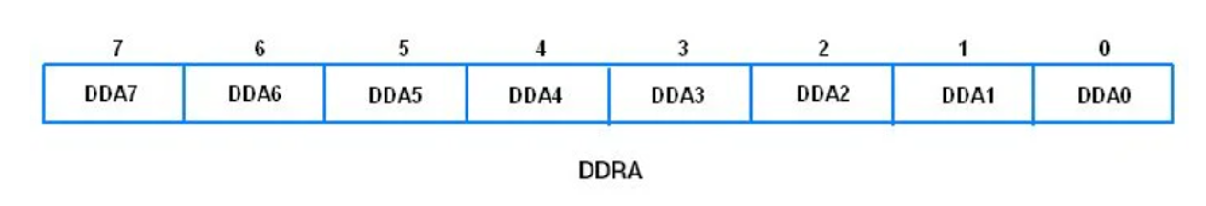
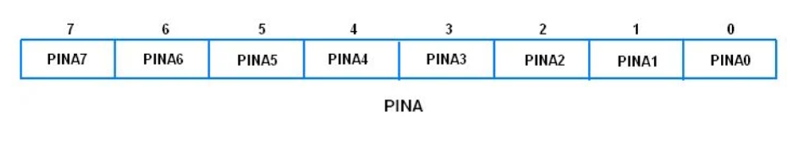
GPIO Control Registers
1- DDRx (Data Direction Register): 1 → Output, 0 → Input.
2- PORTx(Peripheral Output Register): Output mode: write HIGH or LOW,
Input mode: enable pull-up resistor.
3- PINx(Port Input register): Read the actual pin state.

Slide 31
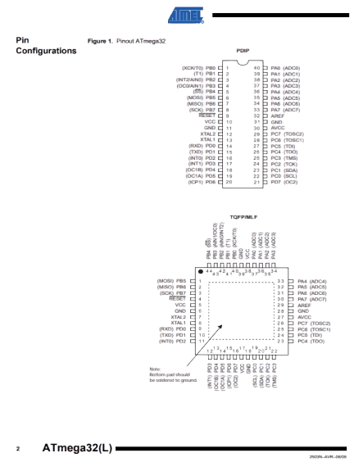
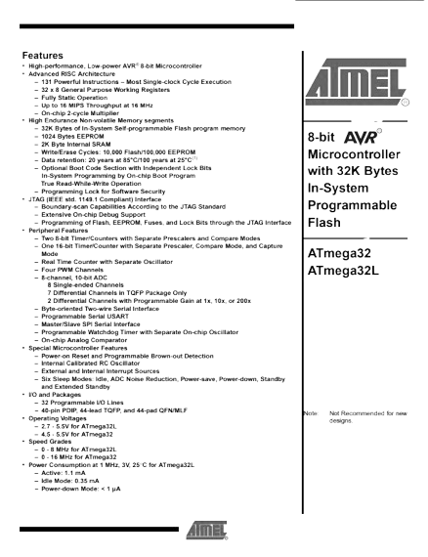
Datasheet Reading

Slide 32
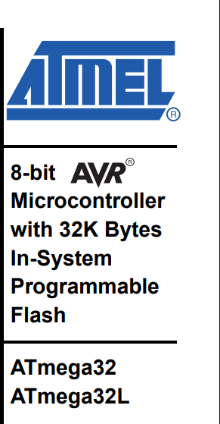
Datasheet is the main reference for the microcontroller
Contains:
Register descriptions
Bit definitions
Memory addresses

Slide 33

Clock System

Slide 34
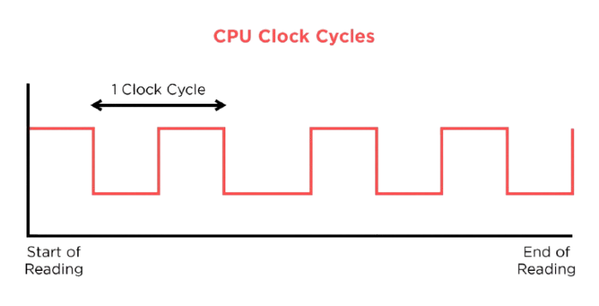
Clock System
Controls execution speed of the CPU Registers update on clock edges.
Common clock sources:(Internal oscillator, External crystal).

Slide 35
Atmega16/32 clock sources
External Crystal Resonator.
External low frequency crystal (32KHz).
External RC oscillator (use XTAL1 Pin only).
Internal calibrated RC oscillator.

Slide 36
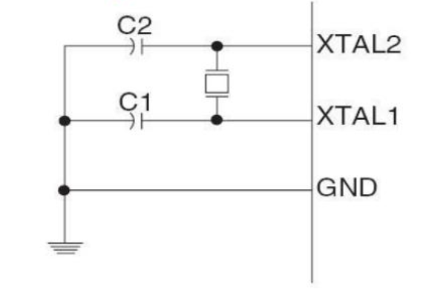
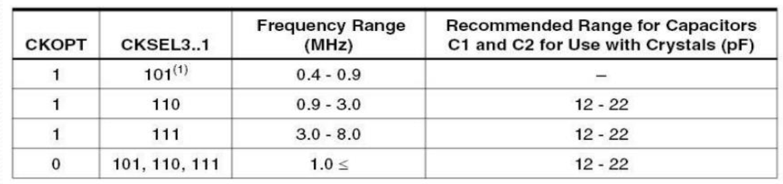
External crystal oscillator
ATmega16/32 can be operated using an external crystal oscillator with a maximum frequency of 16 MHz.
Choose this clock can be done by programming the fuse bits.

Slide 37
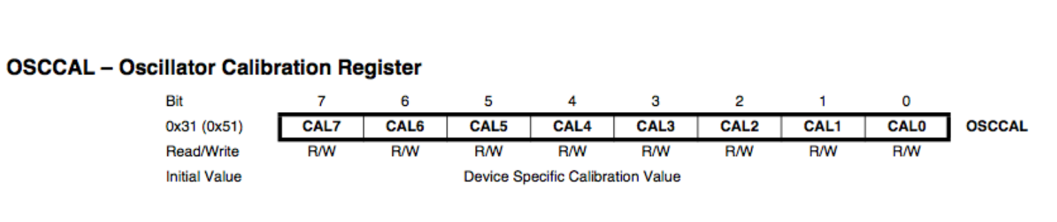
Internal calibrated oscillator
ATmega16/32 is equipped with an internal oscillator for dividing its clock.
The maximum frequency of internal oscillator is 8 MHz.
By default ATmega16/32 is set to operate at internal calibrated oscillator of 1 MHz.
Choose this clock can be done by programming the fuse bits.

Slide 38
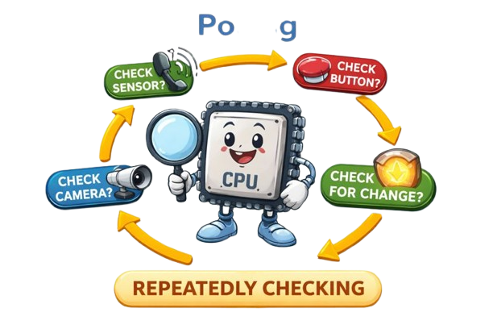
Polling

Slide 39

Polling
CPU continuously checks a register or flag.
Simple but inefficient.
Wastes CPU time.

Slide 40
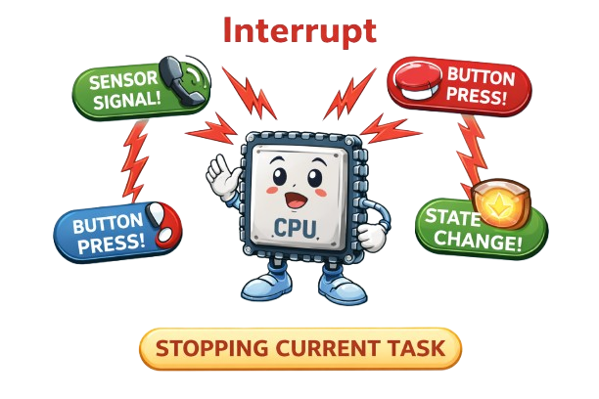
Interrupt

Slide 41

Interrupt
Hardware event notifies the CPU.
CPU stops current task to handle the event.
More efficient than polling.

Slide 42

Task

Slide 43
Questions
Q1: Which registers are used to control the GPIO pins in ATmega32 ?
Q2: What is the function of the PORTx register when the pin is configured as output ?
Q3: What is the resolution of the ADC in ATmega32 ?
Q4: How many ADC Single Ended Input channels are available in ATmega32 ?
Q5: Which register is used to select the ADC input channel ?
Q6: In which registers is the ADC conversion result stored ?

Slide 44
Answers
1: The GPIO pins are controlled using three registers: DDRx, PORTx, PINx. (PN.50)
2: PORTx is used to write logic values to the output pin: (PN.50)
1 → Logic High
0 → Logic Low
3: The ADC has a 10-bit resolution. (PN.201)
4: ATmega32 provides 8 ADC channels (ADC0–ADC7). (PN.201)
5: The ADC input channel is selected using the ADMUX register. (PN.214,215)
6: The ADC result is stored in: ADCL (Low byte), ADCH (High byte). (PN.217)

Slide 45
Assignment (HomeWork)

Slide 46
Questions
Q1: Where is DDR register located (for each port)?
Q2: SRAM Vs Flash?

Slide 47
Thank You!
Any questions?

